Slide 1
Agile Methodology
Group 2

Slide 2
AGENDA
Introduction​
What is Agile
​Agile Methodology in Brief
Agile Vs Waterfall Model
​Scrum
XP

Slide 3
Introduction
Agile is a time-bound, iterative method of delivering software that creates software gradually from the beginning of the project rather than attempting to deliver everything at once.

Slide 4
Why Agile?
The global software industry is forced to operate in a rapidly evolving environment as technology is advancing more quickly than ever.
Customers now value speed and agility in a changing world. They can no longer afford to be bound by lengthy IT projects that, once started, cannot be amended or adjusted.
The meaning of Agile is having a quick resourceful and adaptable character.

Slide 5
Agile Methodology was created specifically to meet the demands of an environment that is changing quickly by embracing the concept of incremental development and creating the actual final product.

Slide 6
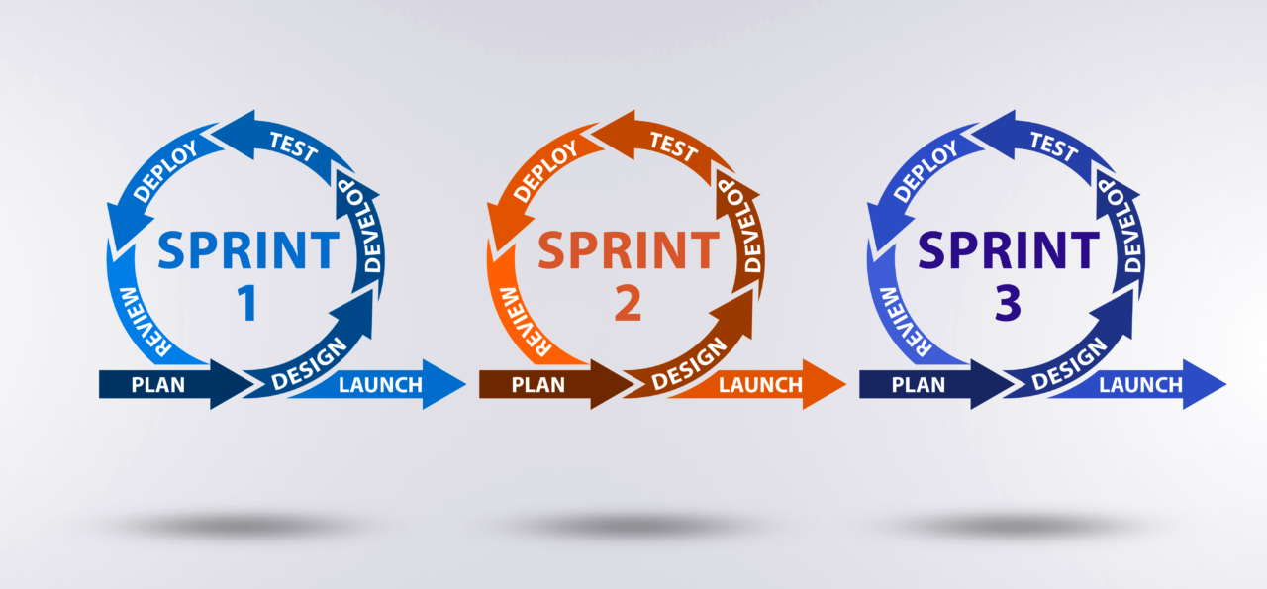
Agile methodology in brief
The Agile project methodology breaks projects into small pieces. These project pieces are completed in work sessions that are often called sprints.
Sprints generally run anywhere from a few days to a few weeks.

Slide 7
Teams can publish segments as they are finished thanks to the Agile methodology.
Because of the ongoing improvement throughout the project lifecycle, it is thought that this reduces the possibility of catastrophic failures.

Slide 8
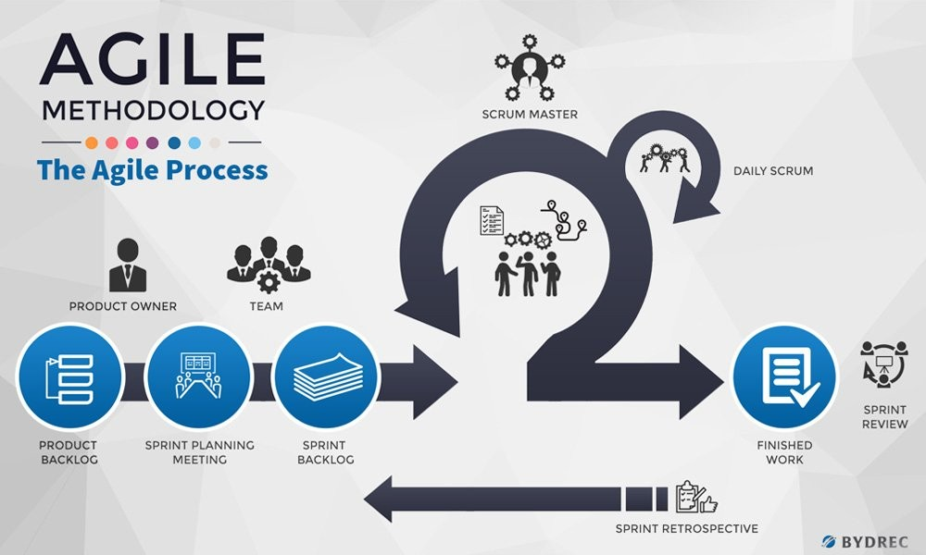

Slide 9
Agile Model | Waterfall Model
Agile methodology definition: Agile methodologies propose incremental and iterative approach to software design | Waterfall Model: Development of the software flows sequentially from start point to end point.
The Agile process in software engineering is broken into individual models that designers work on | The design process is not broken into an individual models
The customer has early and frequent opportunities to look at the product and make decision and changes to the project | The customer can only see the product at the end of the project
Agile model is considered unstructured compared to the waterfall model | Waterfall model are more secure because they are so plan oriented
Error can be fixed in the middle of the project. | Only at the end, the whole product is tested. If the requirement error is found or any changes have to be made, the project has to start from the beginning

Slide 10
Agile Model | Waterfall Model
Development process is iterative, and the project is executed in short (2-4) weeks iterations. Planning is very less. | The development process is phased, and the phase is much bigger than iteration. Every phase ends with the detailed description of the next phase.
Documentation attends less priority than software development. | Documentation is a top priority and can even use for training staff and upgrade the software with another team.
At the end of every sprint, user acceptance is performed. | User acceptance is performed at the end of the project.

Slide 11
SCRUM
“
”

Slide 12
SCRUM is an agile development method which concentrates specifically on how to manage tasks within a team-based development environment.
Basically, Scrum is derived from activity that occurs during a rugby match.
Scrum believes in empowering the development team and advocates working in small teams (say- 7 to 9 members).

Slide 13
Agile and Scrum consist of three roles, and their responsibilities are explained as follows:
Scrum Master
Scrum Master is responsible for setting up the team, sprint meeting and removes obstacles to progress
Product owner
The Product Owner creates product backlog, prioritizes the backlog and is responsible for the delivery of the functionality at each iteration
Scrum Team
Team manages its own work and organizes the work to complete the sprint or cycle

Slide 14
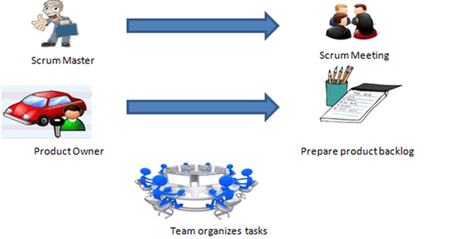

Slide 15
Extreme Programming (XP)
“
”

Slide 16
Extreme Programming technique is very helpful when there is constantly changing demands or requirements from the customers or when they are not sure about the functionality of the system.
It advocates frequent “releases” of the product in short development cycles, which inherently improves the productivity of the system and also introduces a checkpoint where any customer requirements can be easily implemented.
The XP develops software keeping customer in the target.

Slide 17
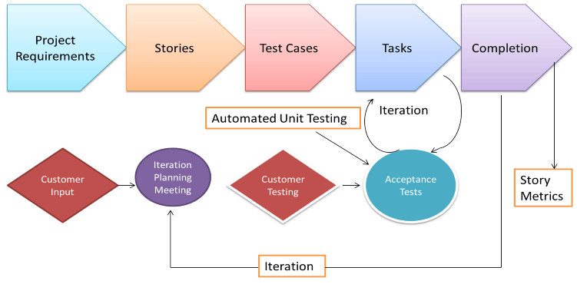

Slide 18
THANK YOU

